Slide 1



Lesson 5.2:
Data Visualization, Part 2

Slide 2
What are UI and UX?
UI – User Interface
How it LOOKS
Colors, fonts, and visual style
Button shapes and placement
Icons, images, and layout
Every screen the user sees
UX – User Experience
How it FEELS
Can users find what they need?
Is the flow logical and easy?
Do users feel confident using it?
The full journey from start to finish

Slide 3

Great Products Need Both
People notice when an app looks polished AND is easy to use
Bad UX drives users away, even when the idea is brilliant
Bad UI makes users distrust an app, even if it works perfectly
Your mockup is a first impression. Make it count.
Great UI/Great UX
Users love it and come back
Great UI/Bad UX
Pretty but frustrating
Bad UI/Great UX
Works well but unattractive

Slide 4
Meet the Tools
UIzard
Best for turning ideas into polished screens quickly
Type a prompt and AI generates a full screen layout
Drag-and-drop editing – very intuitive
Can upload your Datawrapper image directly
Download as PNG on free plan
UXPilot
Best for mapping out the full user journey before visual design
AI helps you plan screens and user flowers step-by-step
Great for thinking through the whole experience
Can upload your Datawrapper image
Downloads not allowed – take screenshots

Slide 5
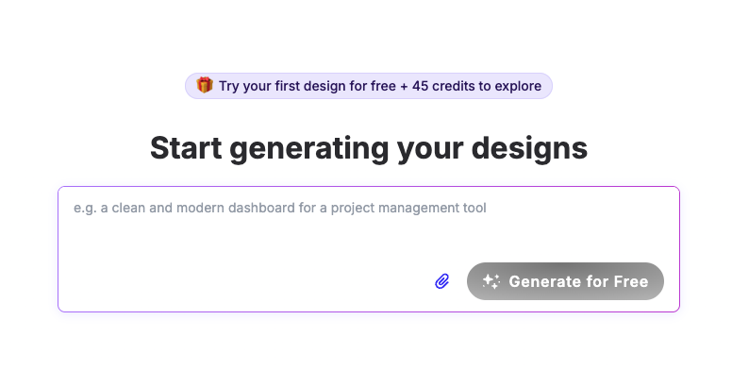

Slide 6
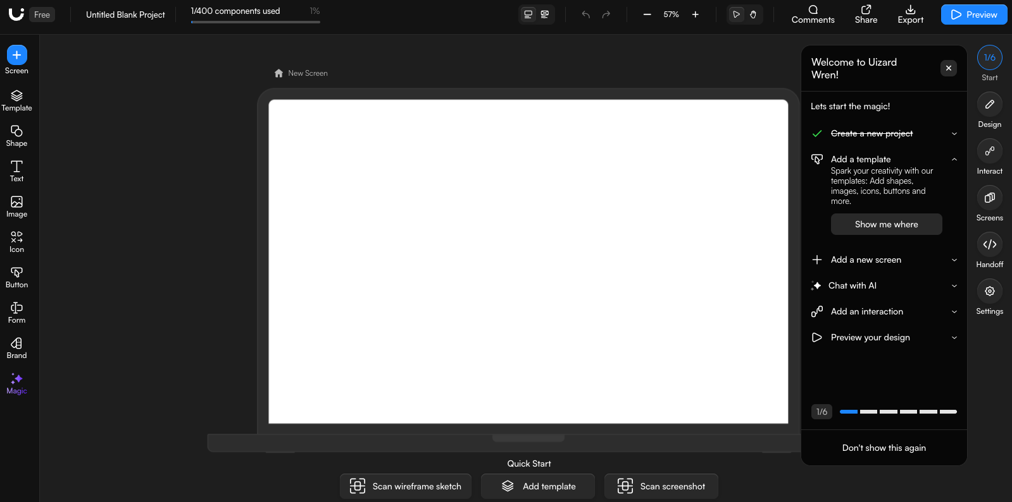

Slide 7
Design Tips
1
Design for your USER — Make choices based on your audience, not what you prefer.
One screen, one purpose — Every screen should answer ONE question for the user.
Readable text always wins — Dark text / light background (or vice versa). Minimum 14pt font for body text.
Make your CTA obvious — CTA = Call To Action (the main button) should be the biggest, most colorful, hardest to miss element on the screen.
Show, don’t just tell — Your data visualization should be visible on the screen.
Less clutter — Whitespace is your friend.
2
3
4
5
6

Slide 8
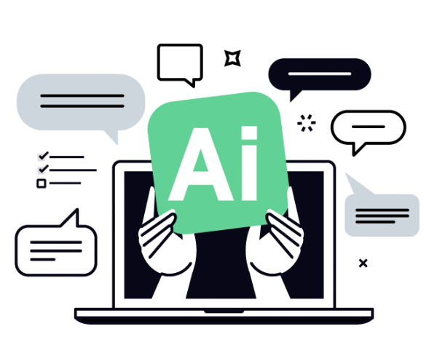
Activity #2: Build Your Mockup
1
30:00
Choose UIzard (uizard.io) or UXPilot (uxpilot.ai)
Sign in with your school login and start a new project
Generate or build your most important screen
Upload your Datawrapper visualization image into the design
Download (UIzard) or screenshot (UXPilot) your finished mockup
2
3
4
5

Slide 9
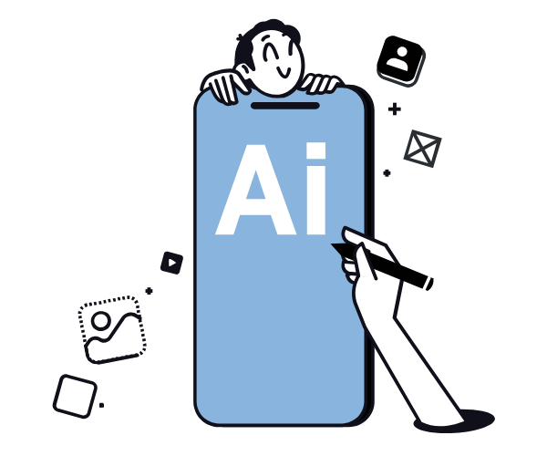
Gallery Discussion
1
Which tool did you use? Why did you choose it?
Show us your screen. What’s the main thing a user would do here?
Where does the data visualization appear? Why did you place it there?
What design decisions are you most proud of?
What’s one thing you would improve if you had more time?
2
3
4
5

