Slide 1



Lesson 5.1:
Data Visualization, Part 1

Slide 2


What is Data Storytelling?
Communicating complex information in a way that’s easy to understand, and memorable, to help audiences make better decisions and take action.
Data - The numbers, facts, and evidence
Story - The meaning and ‘so what’
Action - What audience should do or believe

Slide 3

What is Data Visualization?
The graphical organization of information — using charts, graphs, and maps — to make it easier to see patterns, trends, and outliers.
Bar / Column Comparing categories side by side
Line Chart Showing change over time
Pie / Donut Showing parts of a whole
Table / Map Detailed data or geographic patterns

Slide 4

Why Data Storytelling Matters
Clear data convinces audiences.
✓
Investors want evidence, not just enthusiasm
Visuals help complex ideas land faster than words alone
Good charts build credibility and trust with your audience
✓
✓

Slide 5

Activity #1: Data Storytelling
1
Explore the PowerBI dashboard Spend 3-4 minutes clicking through the data.
Notice what works What chart types do you see? What patterns jumps out? What is the ‘story’ being told?
Group discussion Share your observations. What data storytelling techniques did the creator use? (5 minutes)
  What chart type did the creator choose? Why do you think they picked it?
  What's the main 'story' the data is telling? Can you state it in one sentence?
  Who is the audience for this dashboard? How do you know?
  What would you change to make it even clearer or more compelling?
2
3
10:00

Slide 6
Tips For A Great Visualization
✓
Clear Title — State the insight, not just the topic
Label Everything — Axis, data, legends; if someone has to guess you’ve lost them
The Right Chart — Bar for comparisons. Line for trends over time. Pie only when < 5 slices.
Simple Colors — 1-3 colors max. High contrast = more accessible.
Credit Your Source — Add source citation below chart. Builds credibility.
Less is More — Remove unnecessary gridlines and borders. The data is the hero.
✓
✓
✓
✓
✓

Slide 7
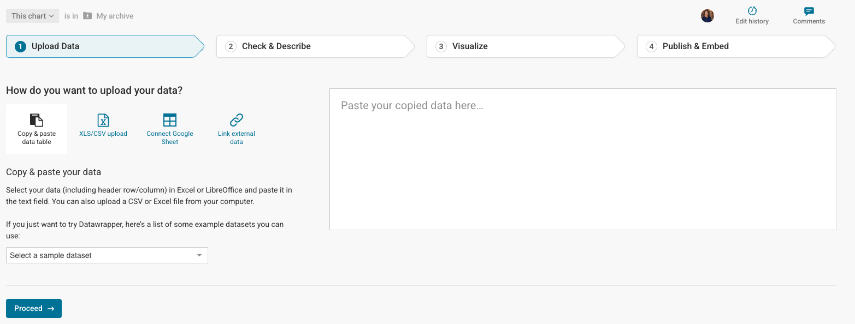
Activity #2: Build Your Visualization

Slide 8
Activity #2: Build Your Visualization
Open Datawrapper (datawrapper.de)
Sign in with school Google login > Click ‘Start Creating’
Enter your data and select a chart type
Customize title, labels, and colors
Download your finished visualization as a PNG
1
30:00
2
3
4
5

Slide 9

Gallery Discussion
What data did you visualize? What story does it tell?
Why did you choose that chart type?
What was the hardest decision you made while building it?
How will this visualization strengthen your project?
1
2
3
4

