Slide 1



Lesson 4:
Using AI Agents for Research
and Comparison

Slide 2
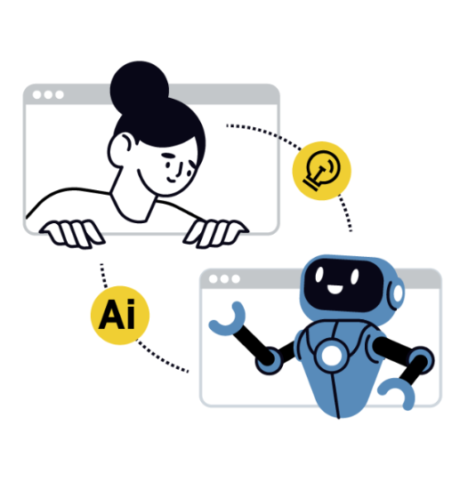
Think About It
You tell Siri
— remind me about stuff —
It sets a reminder, checks your calendar, and texts your friend.
Did YOU do those things or did the AI?

Slide 3
What is an AI Agent?
Not all AI is the same.
Chatbot
You ask a question
It answers
Done
AI Agent
Plan – Breaks the goal into steps
Act – Uses tools: search, code, write
Check – Evaluates what it got back
Adjust – Tries again if needed

Slide 4

Choosing Your AI Agent
Different tools. Different strengths.
Claude - deep research, writing code, building interactive artifacts
Perplexity - real-time web research with cited sources
Canva AI - design + polished visual outputs
ChatGPT - general task, brainstorming, conversation
Pro Move
Use multiple agents strategically - one for research, another for design, another for writing.

Slide 5
The BRIEF Framework
B
R
I
E
F
Background
Situation
Context
Role
Who the AI
should be
Input
The info it
must use
End Goal
What a great
answer looks like
Format
Layout,
length, style

Slide 6
Activity #1: Design Your Agent
I’m a high school student working on a comparative analysis project. I need to objectively compare two options using specific criteria to understand their relative strengths and weaknesses.
Items to Compare:
Item A: [Item A]
Item B: [Item B]
Evaluation Criteria:
  1. [Criteria 1]
  2. [Criteria 2]
  3. [Criteria 3]
  4. [Criteria 4]
  5. [Criteria 5]
Please search the web for current, reliable data about both items. For each criterion:
Provide specific data, statistics, or concrete examples
Cite credible sources with links
Assign a score from 1-10 with clear reasoning
Note any significant differences or trade-offs
Present your findings as a comparison table with these columns:
Criterion
Item A (details + score)
Item B (details + score)
Key Insights
After the table, provide:
A 2-3 sentence summary of key findings
Any limitations or areas where data is incomplete
One surprising insight from the comparison

Slide 7

Activity #1: Design Your Agent
Open the AI Agents Prompting and make a copy
Choose your two items
1
2
Business & Entrepreneurship - e.g. McDonald’s vs Burger King
Sports & Fitness - LeBron vs Jordan
Arts & Entertainment - Netflix vs Disney+
Healthcare - Yoga vs Running
Ecology - Solar vs Wind energy
Computer Science - iOS vs Android
10:00
Pick five criteria
3
Cost/Affordability - Performance/Effectiveness - Innovation/Creativity - Environmental Impact - User Experience - Market Success - Historical Significance - Technical Advancement - Accessibility - Safety Record - Educational Value - Global Reach - Create your own

Slide 8
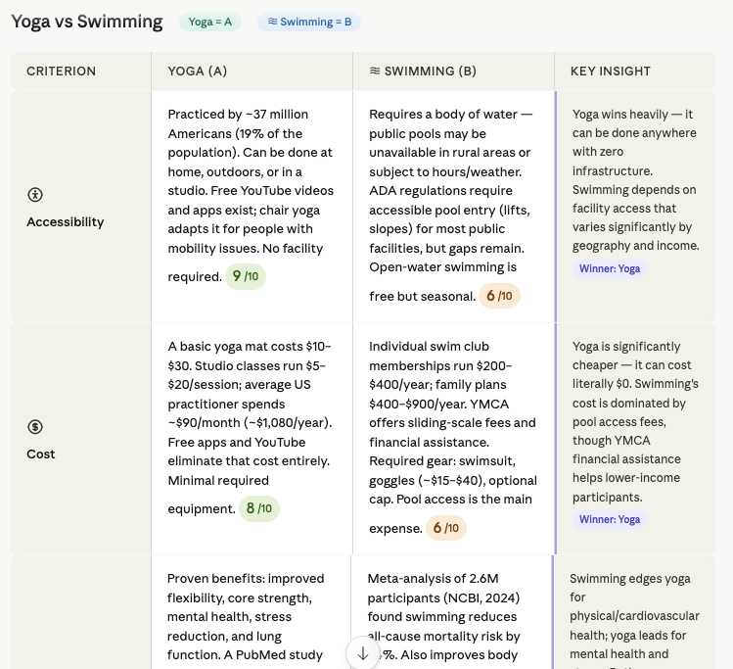

Slide 9
Activity #2: Put Your Agent to Work
WHAT TO DO
Open claude.ai - Sign in/Create an account with your school login
Type your BRIEF prompt - copy from the yellow section of your spreadsheet
Read carefully - Does anything look wrong or surprising?
Push back - “Verify the date for [criterion]” or “Find more recent info”
WHAT TO LOOK FOR
Scores that seem too high or too low
Claims without a source
Data that feels outdated
Clear, specific comparisons
Something you can fact-check
10:00

Slide 10

Debrief – Activity #2
1
What did Claude get right? What did you have to correct or question?
Did your follow-up questions improve the output? What changed?
How could you tell if Claude was being confidently wrong?
2
3
4

Slide 11
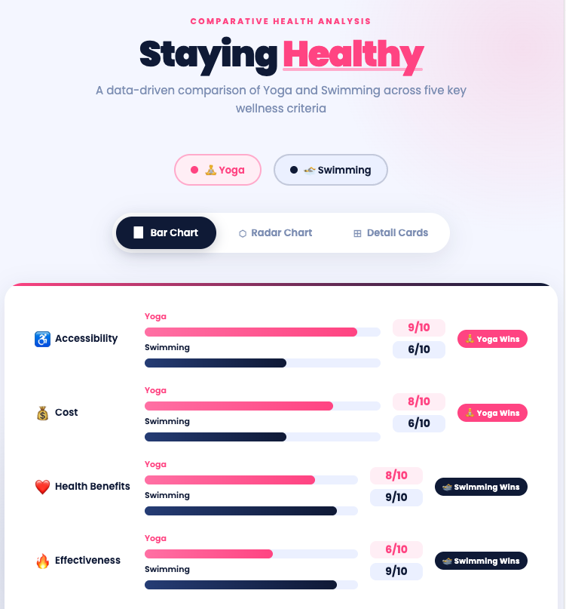

Slide 12
Activity #3: Create an Interactive Artifact
Type this prompt into Claude
Based on our analysis, create an interactive HTML visualization.
Requirements:
- Project Title: [your title]
- Color Scheme: [e.g. pink + dark blue]
- Font: [e.g. Arial]
Include: hover effects with scores,
bar / radar / card toggle, animations,
and a winner indicator per criterion.
Customize first
Add your title, colors, and font before sending
Interact with it
Hover, click, and toggle — does it work?
Specific feedback
"Make bars vertical"
Stuck? Retry
“Rebuild the entire
artifact from scratch.”
10:00

Slide 13

Debrief – Activity #3
1
Walk us through your artifact. What does it show and what surprised you?
Did the visualization change how you read the comparison? Why or why not?
2
4

Slide 14
What is an AI Agent?
AI agents complete tasks – YOU define the goal
What AI agents can do
Search and synthesize vast information
Generate and iterate on code and visuals
Run the same task 1,000 times without fatigue
Complete routine multi-step workflows
What only YOU can do
Decide what question matters
Judge whether the output is trustworthy
Bring real-world context and values
Take responsibility for the result

Slide 15

The AI did the research, built the visualization, and wrote the code.
What did you contribute today?
Does that answer make you feel confident or nervous?

