Slide 1



Lesson 3:
Tutorials Help You Learn Anything

Slide 2

Learning Doesn’t Stop in School
Entrepreneurs
Researchers
Employees
Job Seekers

Slide 3

What is NotebookLM
An AI-powered research tool that thinks inside your sources – not across the whole internet.
✓
You bring the sources Upload articles, links, PDFs, or videos about your topic
AI reads all of them NotebookLM builds its understanding only from what you uploaded
Fewer hallucinations Because it stays within your sources, it’s more accurate than a general AI
✓
✓

Slide 4
3 Parts of NotebookLM
1
2
3
Sources
Articles & links you import
Videos & PDFs
‘Discover Sources’ to find new ones
Select & import with the blue button
Chat
Ask questions about your sources
AI stays inside what you uploaded
Use BRIEF prompts for better responses
Responses include source citations
Studio
Generate briefing docs
Create mind maps
Make flashcards & quizzes
Only 3 audio/video overviews!

Slide 5
The BRIEF Framework
B
R
I
E
F
Background
Situation
Context
Role
Who the AI
should be
Input
The info it
must use
End Goal
What a great
answer looks like
Format
Layout,
length, style

Slide 6

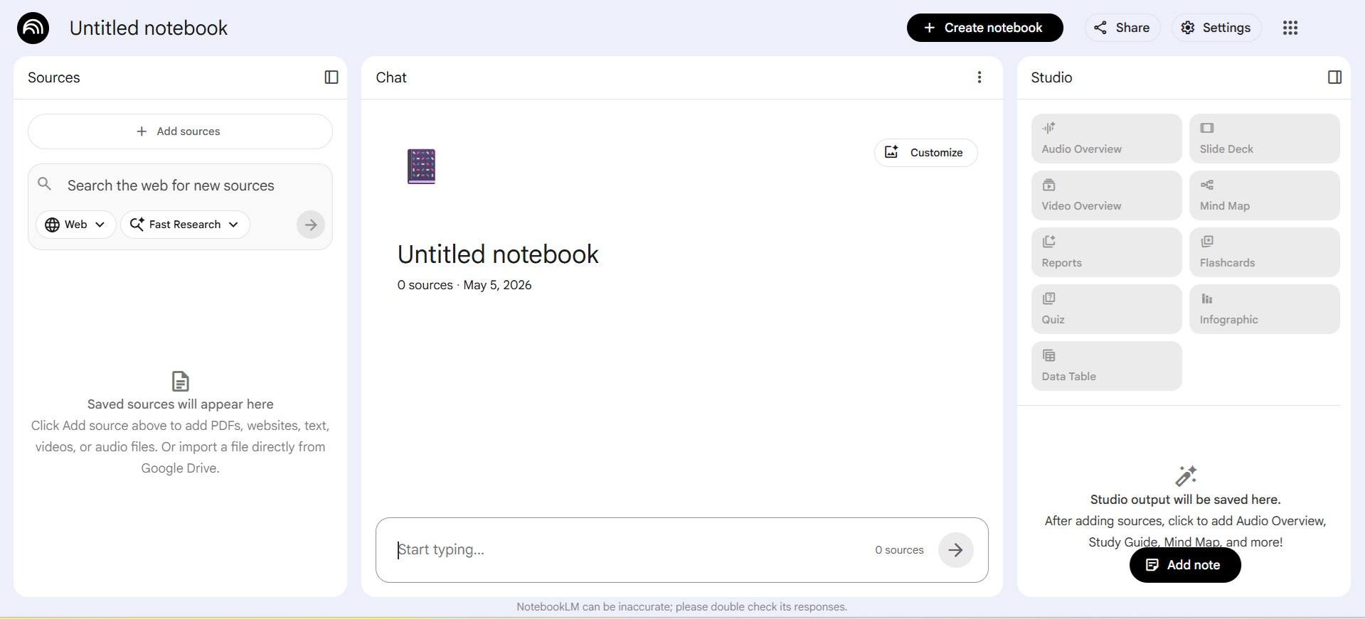
NotebookLM

Slide 7
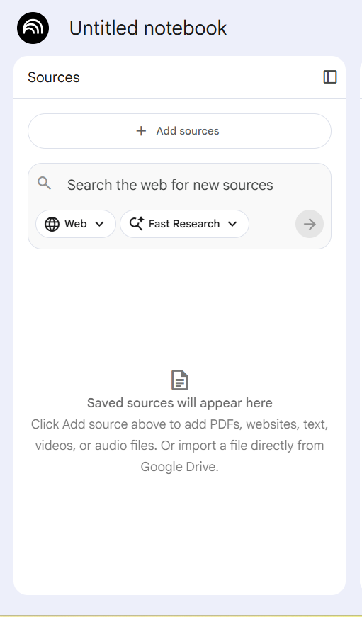

Activity #1: Find Resources
1
Open NotebookLM and create a new notebook (notebooklm.google.com)
Click ‘Discover Sources’ top right — or search in another tab
Search using prompts like AI in [career] How AI is changing [career] Examples of AI in [career]
Check the boxes next to useful sources, then click the blue import button
Explore the Studio panel and generate a study aid
2
3
10:00
4
5

Slide 8
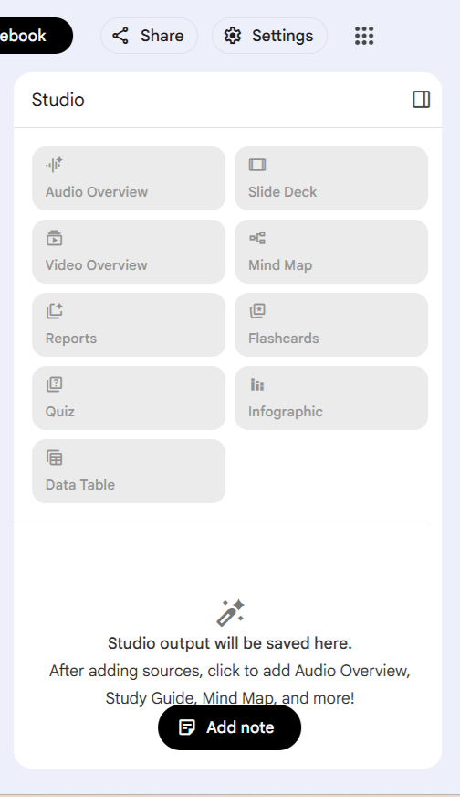
Debrief – Activity #1
1
Briefing Doc A summary of all your sources’ key themes
Mind Map A visual diagram of connected ideas
Flashcards Q&A cards for studying key concepts
Quiz Test your understanding of the material
Audio Overview A podcast-style summary of your sources
2
3
4
5

Slide 9
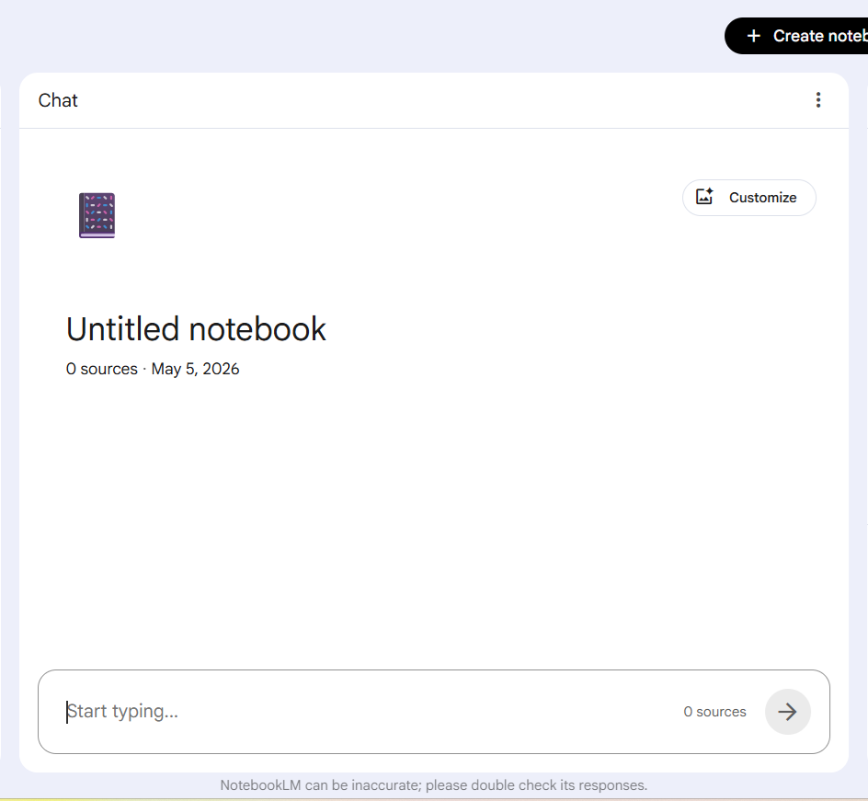
Activity #2: Chat with Your Sources
Add the following prompt to the CHAT panel in NotebookLM
You are an AI tutor that helps high school students design practical AI projects.
I am a high school student who is interested in [career].
Your job is to guide me toward identifying a project idea that connects AI with this field.
Ask me 5 thoughtful questions that uncover: challenges or pain points in this field, opportunities for AI to make an impact, and my personal interests or strengths.
Please number the questions 1–5.
After you answer the questions, continue the conversation to refine your project idea.
15:00

Slide 10

Build Your Goal
A strong goal has three parts:
1
AI opportunity How could AI be applied in this field?
Challenge to be addressed/solved What problem or pain point exists in this career?
Personal fit (why I care) How does this connect to what you care about?
2
3
AI Opportunity + Challenge + Why I Care

Slide 11
Activity #2.2: Build Your Goal
Continue the chat conversation
1
What are the biggest problems or challenges in this career right now?
Where do people in this field struggle the most?
What tasks in this field take a lot of time or resources?
What is one area where AI could be used in the future but isn’t widely used yet?
What is a creative way AI could make this field better for people?
Based on these resources, what is one goal a student like me could set to improve this field using AI?
2
3
5:00
4
5
6

Slide 12

Exit Question
The next time you use AI for something – for school, for work, for anything –
What is one thing you’ll do differently based on what you practiced today?

