Slide 1



Lesson 2:
Lateral Reading with AI

Slide 2

Think About It
Have you ever trusted a source that turned out to be fake?
It’s not “does it look real” —
it’s “can I prove this is real?”

Slide 3


Hallucination
A confident, made-up response.
✓
Not a glitch.
Known behavior of AI systems.
It’s predicting what a convincing answer looks like.
✓
✓

Slide 4


What is Lateral Reading?
Vertical Reading
Lateral Reading
VS
Reading deeply within a single source.
Looking outside your source to evaluate it.

Slide 5
Lateral Reading Strategies
1
2
Research Author & Publisher
Use Wikipedia
Open a new tab.
Search the author name and publisher.
ASK: What do other sources say about this source?
Use it as a starting point to learn about a publisher or author – not as your final source.
3
4
Check for Consensus
Find the Original Source
Are other credible sources saying the same thing?
If only one source makes a claim, that’s a red flag.
If an article references a study or statistic, find the original document.
Does it say what it claims?

Slide 6
Activity #1:
Real vs Fake Using Lateral Reading
Your Task:
1
An LLM was given a prompt and returned 5 article sources.
Some are real. Some are completely fabricated.
Your job: figure out which is which.
2
3

Slide 7
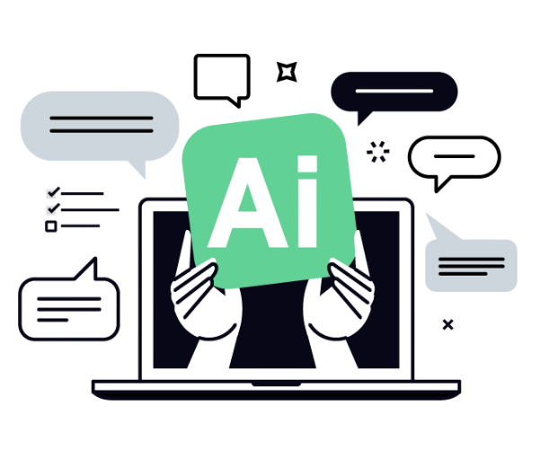
Activity #1: Real vs Fake Using Lateral Reading
How to Do It:
Work in groups of 2-3.
Use lateral reading – don’t just click the link and read the article.
Open new tabs. Search the publisher and author.
Research Author & Publisher
Open a new tab.
Search the author name and publisher.
ASK: What do other sources say about this source?
Use Wikipedia
Use it as a starting point to learn about a publisher or author — not as your final source.
Check for Consensus
Are other credible sources saying the same thing?
If only one source makes a claim, that’s a red flag.
Find the Original Source
If an article references a study or statistic, find the original document.
Does it say what this article claims?
10:00

Slide 8
Debrief – Activity #1
1
Real or fake What did you find? How do you know?
What was the first clue? What specific detail tipped you off that something was wrong – or right?
Would you have been fooled? If you hadn’t checked, would you have believed it? Why or why not?
What’s the danger? What happens if someone uses a fake source in their research without checking?
2
3
4

Slide 9
Activity #2:
Receipts or it Didn’t Happen
If you can’t prove it, you can’t use it.
In this activity you will:
1
Apply the same lateral reading skills to sources you are actually using.
Work through a set of verification questions for each source.
Identify gaps, missing perspectives, and weak sources.
2
3

Slide 10
Activity #2: Questions to Ask
Ask these questions for every source you use:
Does this source exist? Find it. Don’t assume. Can you locate the source right now?
Is it reputable? What do other sources say about this publisher or author? Use lateral reading to check.
Is it current? When was it created? Is it recent enough to still be accurate for your purpose?
What’s missing? What perspective might be left out? Who might see this topic differently?
Can you replace it? If this source disappeared tomorrow, could you find alternatives to support your point?
When using images, music, or writing – ask these too:
Is proper credit given to the original creator? Does your work clearly identify
where this content came from and who made it?
Are cultural elements being used appropriately? Is the cultural content being
used in a way that is respectful and not exploitative?
What are the license and usage rights? Are you legally and ethically allowed
to use this content for your purpose?
20:00

Slide 11
Debrief – Activity #2
1
Was any source less reliable than you expected? What tipped you off? Was it the author, the publisher, the date, or something else?
Was any source stronger than you expected? What made you more confident in it once you investigated?
Did you have a source that couldn’t be verified at all? What did you do- or what would you do – when a source can’t be confirmed?
Was there a hard question to answer? Why? Was it harder to check existence, reputation, currency, missing perspectives, or alternatives?
2
3
4

Slide 12

Verification is not about assuming everything is a lie.
It’s about building confidence in the information you use.

