Slide 1



Lesson 1:
Effective Prompting with BRIEF

Slide 2

Think About It
If your phone autocompletes a text for you and it was actually good:
Did you write that or did the AI?

Slide 3
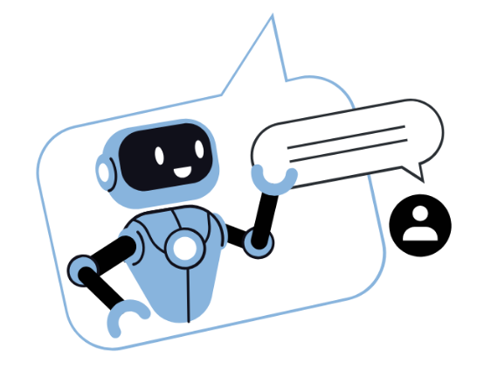

LLM (Large Language Model)
Understands and generates human language
✓
Trained on billions of pages of text to learn language patterns
Predicts the most likely next word – like autocomplete, but vast
Can produce errors because it predicts, not understands
Each LLM is built differently – so each has different strengths
✓
✓
✓

Slide 4
The BRIEF Framework
B
R
I
E
F
Background
Situation
Context
Role
Who the AI
should be
Input
The info it
must use
End Goal
What a great
answer looks like
Format
Layout,
length, style

Slide 5


Background
Ask yourself - What does the AI need to know to help me?
Examples
1
2
3
I’m a 9th grader writing
a persuasive essay for English class.
I have $40 and no car. It’s Saturday in Austin, TX.
I’m designing an app for students who lose track of homework.

Slide 6

Role
Ask yourself - What kind of expert would give me the best answer?
Examples
1
2
3
Act as a local tour guide.
Respond as a peer tutor explaining this to a classmate.
You are a UX designer
for a startup.

Slide 7

Input
Ask yourself - What specific information should the AI use?
Examples
1
2
3
We like thrift shops, street food, and live music.
Here is the paragraph I want to improve [paste text]
The product is a backpack with a built-in phone charger.

Slide 8

End Goal
Ask yourself - What does 'done well' actually mean for this task?
Examples
1
2
3
A timed Saturday plan with transit directions and total cost under $80.
3 headline options I can A/B test.
An explanation a 6th grader could follow in under 2 minutes.

Slide 9

Format
Ask yourself - What layout, length, or style is needed?
Examples
1
2
3
Table with columns: time, place, cost, travel method.
Bullet list, max 5 items, each under 10 words.
A short paragraph, casual tone, no jargon.

Slide 10
BRIEF in Action
Weak Prompt
Strong Prompt
Plan my weekend.
We are two friends without a car and have $40 each. We live in Austin, TX.
Act as a local guide.
We like thrift shops, street food,
and live music.
We need a timed plan with transit directions for under $80.
We want a table with column headings time, place, travel, and cost.
We also need a plan in case it rains.
VS

Slide 11
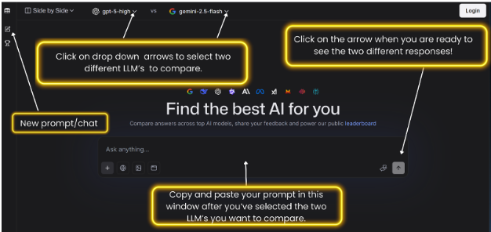
LMArena

Slide 12

Activity #1: Comparing LLMs
1
Open the LLMs Comparison spreadsheet
Read the prompts critically and improve them using the BRIEF framework
Open LMArena
Select 2 AI models and note those in the spreadsheet
Paste your prompt into LMArena and decide which one did a better job
Record that in the LLM spreadsheet
18:00
2
3
4
5
6

Slide 13
Activity #2: Prompt Optimization
Improve this prompt using BRIEF:
Design a new social media app.
10:00
1
Work through each BRIEF letters together — each person contributes at least one idea.
Decide as a group which LLM to use for this task — and be ready to defend why.
If time allows “Battle It Out” and test your prompt and compare with another group.
2
3

Slide 14
Debrief
1
Walk us through your improved prompt — what did you add for each BRIEF letter?
Which LLM did you choose for the social media app task — and why that one specifically?
Did one LLM consistently win, or did it depend on the task?
Did prompt quality matter as much as — or more than — which LLM you chose?
2
3
4

Slide 15




3 Things to
Remember
LLMs predict — they don’t understand.
They can be confidently wrong. Always verify.
Different LLMs are better at different tasks.
The best tool depends on what you're trying to do.
Your prompt is an input,
not just a question.
Better prompts using BRIEF = better outputs, regardless of which model you use.

Slide 16

The next time you
use AI for something
What’s one thing you’ll do differently?

